Slide 1



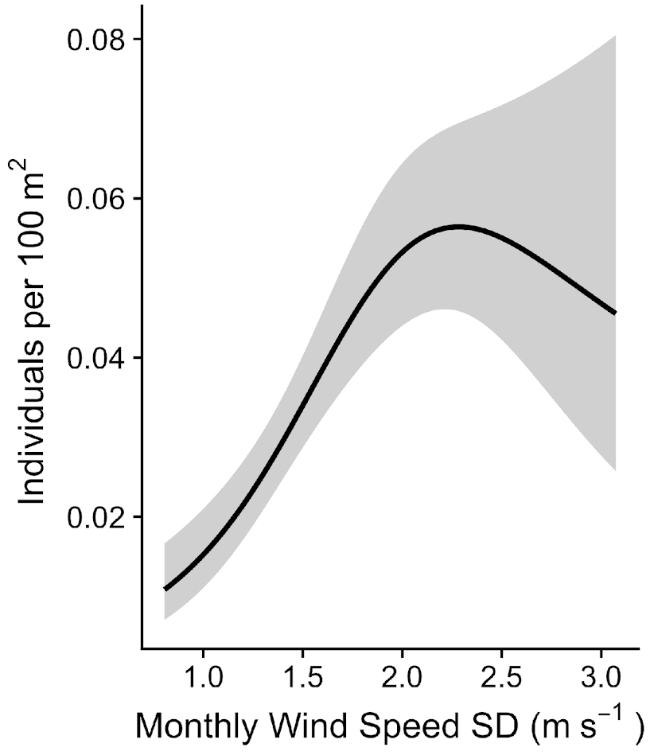
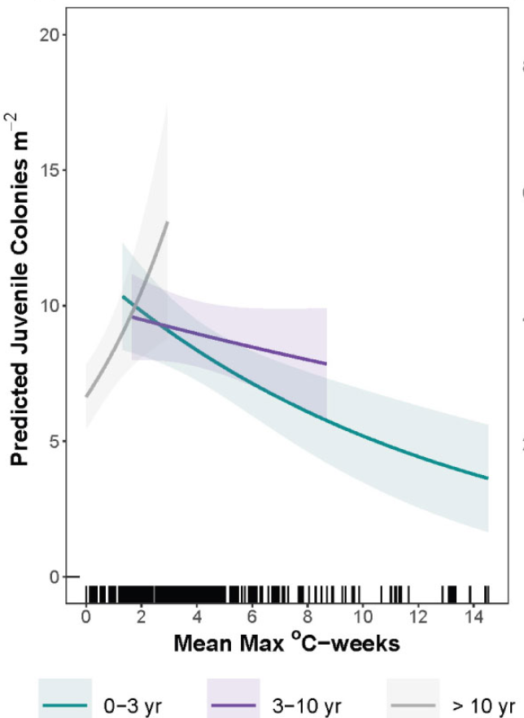
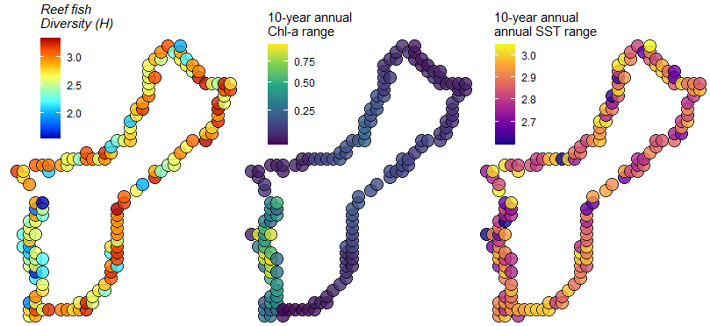

Environmental Data Summary (EDS): A tool to enhance in situ data with temporally summarized external variables
Survey data
Example EDS outputs
Gridded open-source datasets
Site | Lat | Lon | Time | Fish/m² | Weekly Max SST | Monthly Chl-a SD | 10 years Precip range | Pop Density | Total Effluent
A | 18.56 | -154.84 | 15-Aug-22 | 3.2 | 24.61 | 0.3 | 25.5 | 432 | 3.2
B | 19.55 | -154.85 | 4-Jun-22 | 5.5 | 28.61 | 0.5 | 6.2 | 34 | 22
C | 19.48 | -154.75 | 17-Mar-22 | 2.1 | 24.75 | 0.8 | 4.3 | 345 | 7.4
EDS integrated into 30+ projects (install_github('krtanaka/eds')
Quantified species-
environment relationships
Environmental factors shaping reef fish diversity?
Tanaka et al. 2022
Couch et al. 2023
Tanaka et al. In Prep
Presented by kisei.tanaka@noaa.gov

